Slide 1
VETNETSEC
Security Testing for Extremists
BY
_{E}riC _{H}aCKeR

Slide 2
Agenda
I’m going to talk really fast to cover another 27 slides in less than 25 minutes so there is still 5 minutes for questions.

Slide 3
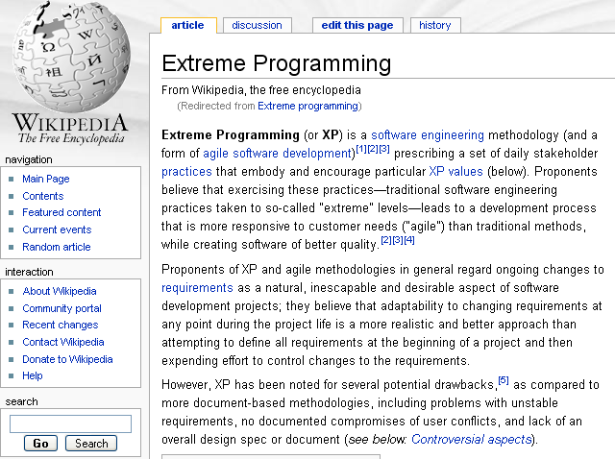
Extreme Programming
Activities
Coding
Testing
Listening
Designing

Slide 4
Security Extremists
Requirements change constantly
Configuring = Coding
  Firewalls
  IDS / IPS
  AV / Spam Filters
Listening
  We sure do listen when security breaks something.
Designing
  Defense in depth

Slide 5
Where is Testing?
For years security experts have been griping about inadequate Software Quality Assurance
What about Security Quality Assurance?

Slide 6
Problems with current testing
Not always easily repeatable
Requires manual interpretation for pass / fail
Network security testing requires log matching/synchronization
Vulnerabilities are not Disabilities (or Abilities)
My network is not a Black Box
Testing process is not easily automated
  Centralized infrastructure not helpful
  Comparative scans only work if first one was valid

Slide 7
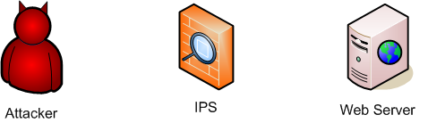
Perspectives on Testing
Mr. QA

Slide 8
Primary Goals for VetNetSec
Wrap security tools into the Test Anything Protocol framework used for software testing
Real time coordination of distributed testing agents
Open, standards based, extensible, flexible
Provide greater accessibility to security tools for programmers and QA testers

Slide 9
How does VetNetSec work?
Open Source
Open Standards:
  Perl, using modules
  XMPP / Jabber
  Test Anything Protocol (http://testanything.org)
Distributed TCLI Agents communicating out of band in real time
  Agents have plug in functionality with Packages of commands
Manual or scripted control
  Jabber IM clients
  Perl test scripts
Debug functional testing
Notes:
How does VetNetSec work?
VetNetSec uses one or more agents that are installed on machines in the environment to be tested. These agents communicate with each other over XMPP through a central server. This avoids any problems with direct communication through the network security.
Agents are written in Perl using script templates and TCLI packages . TCLI is a modular testing engine that provides the core packages and framework for the VetNetSec system. Modularity is important to providing as much cross platform compatibility, while still allowing specialized tests as necessary. For instance, some specialized attack capabilities for simulating DDOS attacks are only supported on FreeBSD or OpenBSD, so an agent running on Linux that just needs to verify that ports are open through a firewall can skip those packages.
Agents are controlled through a command line interface that aims to be easy to use for those who don't want to have to learn yet another application. One can access agents through any Jabber IM client and run individual commands as necessary.
Once agents are set up and communicating with a server, one writes test scripts in Perl that direct the agent's actions. One does not need to know Perl in order to write these test scripts. One can use the template and just add tests like:
$outside_agent->ok('http tget url http://www.example.com response_code 200');
$outside_agent->not_ok('ping target www.example.com');
Of course, much more functionality is provided (and is coming) within the system. Also, since the scripts are in Perl, one can use Perl to enhance test scripts if necessary.
The run the test, one can simple run 'prove test.t' on the command line. The test will report either success, or failure with additional information on what tests failed. VetNetSec uses the open TAP Test framework (http://testanything.org), so it may be integrated into other test systems, used in scripts, and should be able to leverage other reporting tools over time.

Slide 10
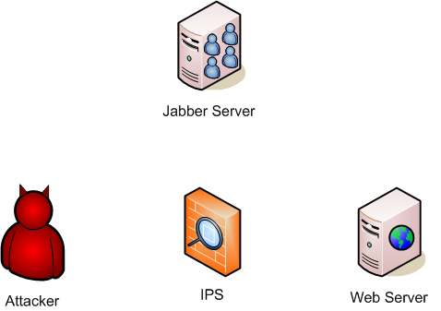
Command and Control
Web Server: Attack me
Attacker: I’ll try
Attacker attacks.
Attacker: OK, I’m done

Slide 11
Terminology
Agent - A system running an agent and waiting for commands
TCLI - Transactional Command Line Interface
Command - The action that an Agent should take
Context - The position within a nested command state
Action – Something the agent will do
Parameters - The collection of objects that the action works with/on
Test Master - The system on which the test script is run

Slide 12
Terminology (2)
Package - A collection of related commands that adds functionality to an Agent
Transport - The protocol used for Agent communications
Users - Those with rights to communicate with an agent
Resource - A Jabber concept that allows one user to be logged in with multiple clients

Slide 13
Talking TCLI: the User Interface
Response status codes for automation
Command Contextual: Cisco like nested verbs (commands)
Object Contextual: argument context through command specific parameters
Notes:
Talking TCLI: A quick overview of the User Interface
The TCLI interface is designed to be easy to figure how to work with new actions that have been added to support new testing capability. The basic format of every request is <command> <parameters>. <command> will consist of one or more words that will indicate what one wants the agent to do. <parameters> will provide additional named elements for use with the command.
Commands are contextual, allowing one specify the whole command at once or to drill down to the specific command to be used. This allows relatively easy access to commands that one is familiar with. It also supports an interactive learning as opposed to forcing one to use separate manuals.
The specification of parameters is also designed to make it easier to work in the TCLI. Parameters are always name=value pairs or just the name in some cases. Spaces separate the parameters, so the value should be enclosed in double quotes if it contains a space. The order of parameters does not matter, though the name always needs to precede the value. The separator between names and values may be a space or an equal sign, but not both.
These are valid parameters:
name=value
name value
name "value has spaces"
Packages usually maintain stateful default parameters during a session. This helps when one needs to repeat an action several times with most of the parameters remaining the same. One can use the set command to establish the desired default parameter to use when it is not provided. One can use the show command to see the default parameters that are currently set.
A simple example: suppose one wants to set up a test to ping several hosts, but instead of using the default timeout of 10 seconds, one wants to set the timeout at 5 seconds for each one. One could specify the timeout each time, or use the set command to set the default timeout to 5 seconds for all ping tests.
<Ping transcript here>
Ping is a simple command with only three parameters, so the benefit is not as obvious as with a command that can take twenty parameters. Parameter state is only maintained within a Package and do get shared between them. This means that the timeout for ping and the timeout for traceroute are not shared. Currently there is no mechanism to save parameter state between sessions.

Slide 14
TCLI Command Examples
nmap set no_ping
nmap set ports=80,443,8080
manual nmap
nmap set syn_scan
nmap scan target=192.168.1.0/24
nmap scan target=192.168.254.0/24
OR
nmap
set no_ping
set ports=80,443,8080
manual nmap
set syn_scan
scan target=192.168.1.0/24
scan target=192.168.254.0/24
OR
nmap scan target=192.168.1.0/24 -P0 -p 80,443,8080 -sS

Slide 15
Installation and Setup
Installation is too hard
Load Perl modules from CPAN
  Lots of module dependencies
Set up agent script
Set up Jabber account(s)
Write test script
Notes:
Installation and Setup
Installation requires Perl and many Perl modules. For Windows, one can use PPM to install the packages from the latest zip archive. This will also automatically install the necessary dependencies, if PPM is set up according to the instructions in the .zip file.
For Unix, the VetNetSec system is distributed in a tar.gz which must be unzipped. One should check the README for the full list of Perl modules required is dependent on as well as more detailed installation instructions. The Build script will warn of needed dependencies if it does not find them. One can use CPAN to install dependencies easily.
Once the dependencies are installed, then one can simply run:
perl Build.PL
./Build
./Build test
./Build install
It is hoped to have an agent system running in a VMWare client soon to make it easier to experiment with.
Agents can be set up to log in to chatrooms so that multiple people can work with them collaboratively.
Agents (and their operators) need Jabber accounts to communicate, though some standalone test scripts will work without one. Agents currently cannot self register, so one must use a Jabber client like Exodus to perform the initial registration for the agent. Then putting the credentials in the agent script will allow it to log on.

Slide 16
Creating an Agent Script
Hack the example agent scripts!
Set run-time default parameters
  Domain
  Username
  Password
  Resource
  Host
  Master
  Verbose
Load required modules
Load optional package modules

Slide 17
Creating an Agent
Create new package objects to load each package into agent
Define the authorized users of the agent
  id => jabber id
  protocol =>
    xmpp
    xmpp_groupchat
  auth =>
    master - full rights / root
    writer - some control as dictated by commands
    reader - read only access
    logger - receives copies of all messages but cannot interact at all
Create Transport and go

Slide 18
Talking to an agent over IM
Basic Commands
  root or /
  exit
  help
  man
  pwd or context
  status
Command packages add their own commands
Following good practices will allow quick familiarity with different command packages
Common sub commands
  set - adjust the default parameters
  show - show default parameters
  help
    Overall help
    Detailed help on parameters
Notes:
Talking to an agent over IM
[08:07:16] <hacker> hello
[08:07:17] <testy1> hello hacker. Tell me what you'd like to do or ask for 'help'.
[08:07:29] <hacker> help
[08:07:30] <testy1> The following commands are available in this context.
Control - show or set Control variables
Hi - Greetings
http - http web cient environment
httpd - simple http web server
ip - Returns the local ip address
jabber - manipulate the jabber/xmpp transport
ping - check to see if a host is alive
smtp - smtp client to send mail
tail - tail a file
traceroute - determine route to a host
xmpp - manipulate the jabber/xmpp transport
The following global commands are available.
/ context exit help man manual pwd root status

Slide 19
Command Example: Tail
clear - clears out a cache
file - manipulate files for tailing
  add - designate a file for tailing
  delete - delete a tailing of a file
log - add text to the line queue
set - adjust default settings
show - show tail default parameters and state
test - one time pass/fail
  add - add a new tests on the tails
  delete - delete a test on the tails
watch - continuous monitoring for match
  add - add a new watches on the tails
  delete - delete a watches on the tails

Slide 20
Tail Test/Watch Parameters
ordered - process tests in order set or not
line_max_cache - line history for tests that get set after event
line_hold_time - time to hold a line in the cache
test_max_lines - how many lines a test will observe before failing
test_match_times - how many times a test should match
test_ttl - time to live for a test before failing
test_verbose - test debugging
test_feedback - detailed reporting vs pass/fail

Slide 21
Running tests
Tests complete asynchronously
  That changes a lot of things from typical software tests
Tests are queued and then run
  Timing is hard to predict
  Extra test commands for coordination
Timers are used to terminate test script if it fails to complete
Script needs to shutdown its XMPP transport in order for test to complete

Slide 22
Writing a test script: Setup
Hack an existing test script!
Import modules required
Load optional packages
Set up transport
Set up Test Master
Set up local and remote test agents
Test Master (Local)
Remote

Slide 23
Test format: <agent object> -> <test function>(command)
# Remote up?
$remote->ok('status');
# get remote IP address
$remote->ok('Control show local_address');
my $target = $remote->get_param('local_address','',30);
#add a new response to the webserver
$remote->ok('httpd uri add regex=/okgo.* response=OK200');
# start remote web server with logging
$remote->ok('httpd set logging');
$remote->ok('httpd spawn port=80');
# make sure those actions completed before proceeding
$test_master->done;

Slide 24
# have local query the remote webserver.
$local->ok('http tget url=http://'.$target.'/test1.htm resp=404');
$local->ok('http tget url=http://'.$target.'/okgo2.htm resp=200');
# check to see if query is in the logs
$remote->ok('tail test add like=test1', 'passed test1');
$remote->ok('tail test add like=okgo2', 'passed okgo test2');
# have local attack the remote webserver.
$local->ok('http tget url=http://'.$target.'/test3.htm resp=404');
$local->ok('http tget url=http://'.$target.'/okgo4.htm resp=404');
# check to see that attack is not in the logs
$remote->not_ok('tail test add like=test3', 'passed test3');
$remote->not_ok('tail test add like=okgo4', 'passed okgo4');

Slide 25
# shut down httpd
$remote->ok('httpd stop port=80');
# make sure to shut down the transport so the script will stop.
$local->ok('xmpp shutdown');
# Though tests will start during building of the tests
# all tests will not complete until the master run is called.
$test_master->run;

Slide 26
Use cases
Firewall / IPS regression testing
Security Product evaluation
Security functional testing
Etc.

Slide 27
Current Command Packages
Tail - Tail a text file
XMPP - Manage XMPP transport on an Agent
HTTP - Simple URL requests
HTTPD - Simple web server to receive attacks
SMTP - Send email
Ping - Perl ping
Traceroute - Perl traceroute

Slide 28
Coming Soon Packages
nmap interface
tcpreplay interface
pf (OpenBSD firewall) interface
Hping interface
advanced HTTP control
Snort??

Slide 29
Conclusion
Obtaning Code
  Currently use CPAN. Search for:
    Module - Agent::TCLI and Agent::TCLI::Net
    Author – Hacker
  Soon to be at vetnetsec.org
Contact: hacker at vetnetsec.org
Questions?

